Slide 1

Differentiation Through
Wendy Phillips , M.S., Literacy Specialist
Coordinator of Reading
Lynn Everett
Coordinator of Inclusive Practices
Margaret Vaughan
Coordinator of E.C.S.E. Services
Virginia Department of Education’s
Training & Technical Assistance Center (T/TAC)
@ Virginia Tech
Notes:
Margo discuss packets

Slide 2
Agenda
8:30-9:00: Registration & Breakfast
9:00-9:55: Balanced Literacy
10:00-10:40: Session 1
10:45-11:20: Session 2
11:25-12:00: Session 3
12:00-12:15 Break
12:15-1:00: Literacy Resources & Action Planning
Rotations:
*Guided Reading: Room 240
*Assessment: Room 226
*Literacy Stations: Room 231
Notes:
Margo

Slide 3
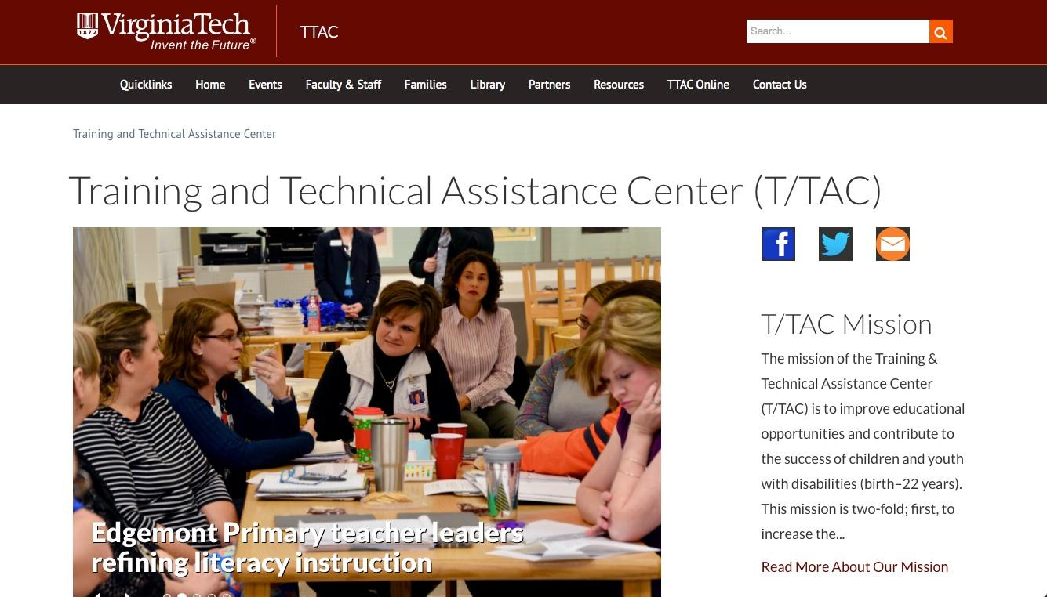
http://ttac.vt.edu/Resources/Literacy
Notes:
Literacy page has link to presentation

Slide 4
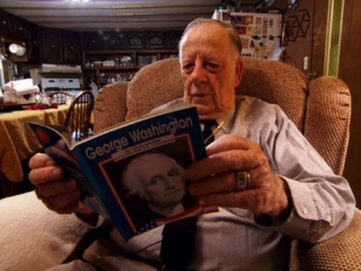

Slide 5
Do you know an Ed Gray?

Slide 6
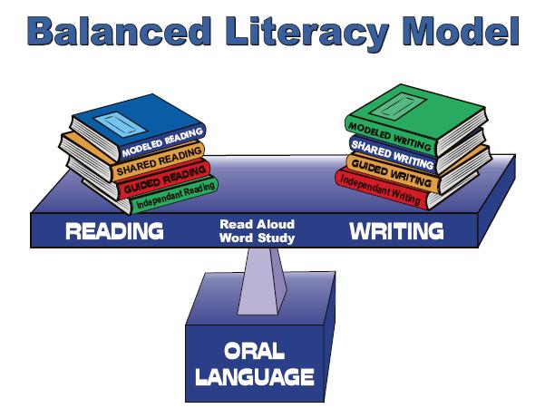
https://erinpetley.files.wordpress.com/2014/02/balanced-literacy1.jpg

Slide 7
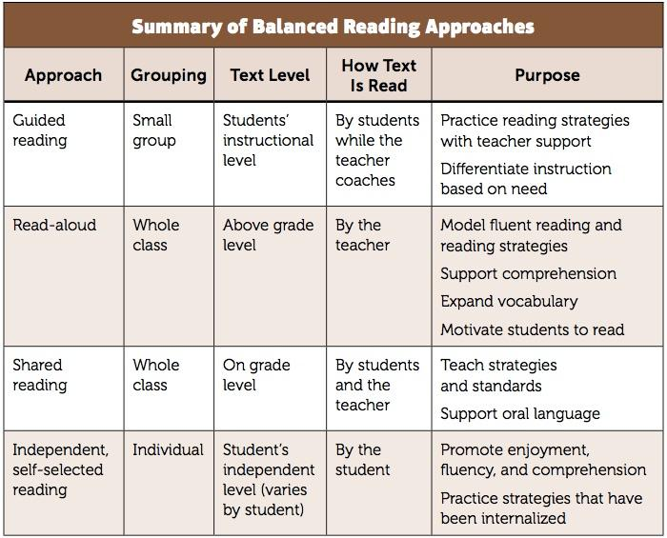
Instructional Contexts for Reading
Richardson, J. (2016). The next step forward in guided reading: an assess-decide-guide framework for supporting every reader. New York, NY: Scholastic

Slide 8
What is Differentiated Instruction?
Differentiated instruction is matching instruction to meet the different needs of learners in a given classroom. The range of instructional need within one classroom is large. In order to accommodate these instructional needs, it is recommended that teachers plan for:
• small group, differentiated instruction
• ample student practice opportunities in the form of
Literacy Centers/Workstations
http://www.fcrr.org/assessment/pdf/smallGroupAlternativeLessonStructures.pdf
Notes:
Florida Center for Reading REsearch
How do you ensure differentiation

Slide 9
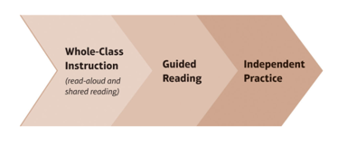
Literacy Block
Each lesson should build upon the state standards lessons you teach in whole class instruction using read alouds and shared reading experiences. Teachers select books at students’ instructional level for guided reading. Students read text at their independent level while the teacher teaches her guided reading groups.
Richardson, J. (2016). The next step forward in guided reading: an assess-decide-guide framework for supporting every reader. New York, NY: Scholastic

Slide 10
Guided reading does not stand alone, it should be part of your Literacy Block/Reading Workshop!

Slide 11
A balanced literacy approach that combines holistic and systematic, explicit instruction, and incorporates daily reading, writing, and word study is critical for all learners, including those with significant disabilities. (Carnahan, Hollingshead, Israel, and Williamson, 2012)

Slide 12
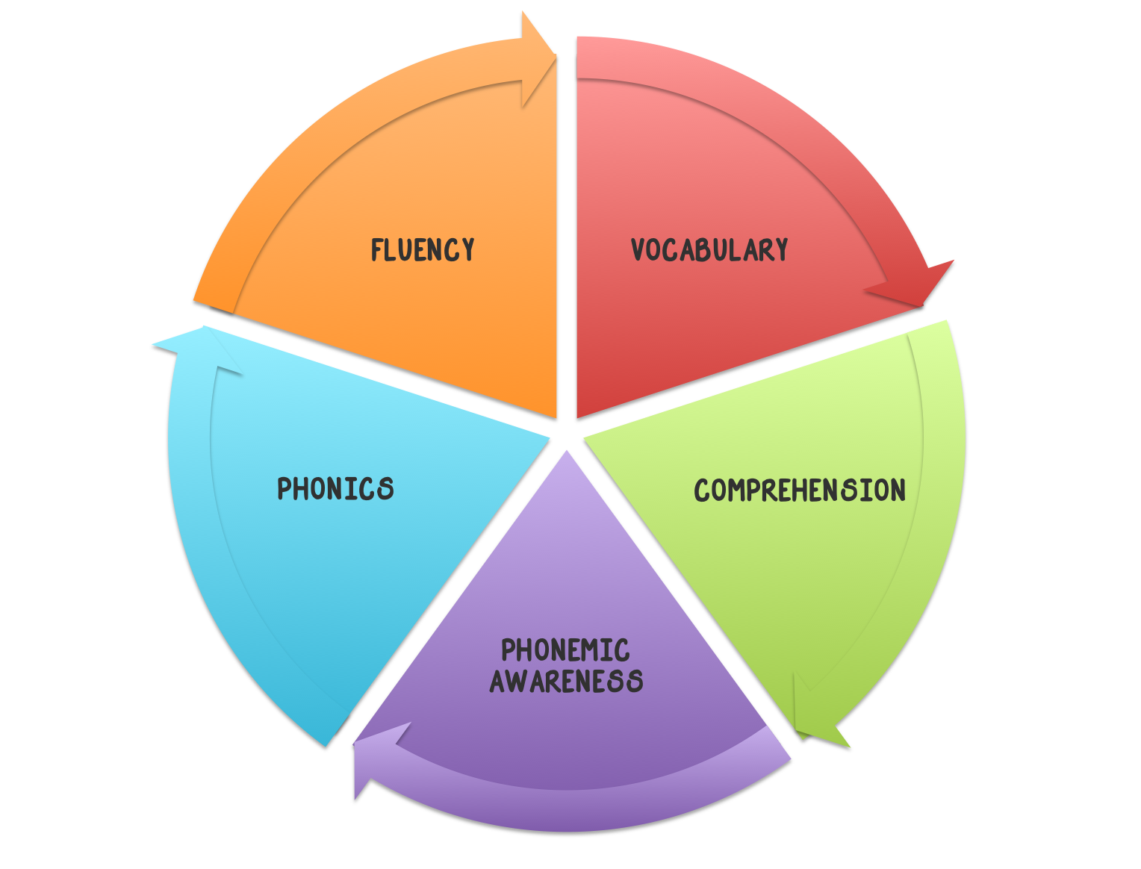
5 Components of Reading
Resource Map

Slide 13
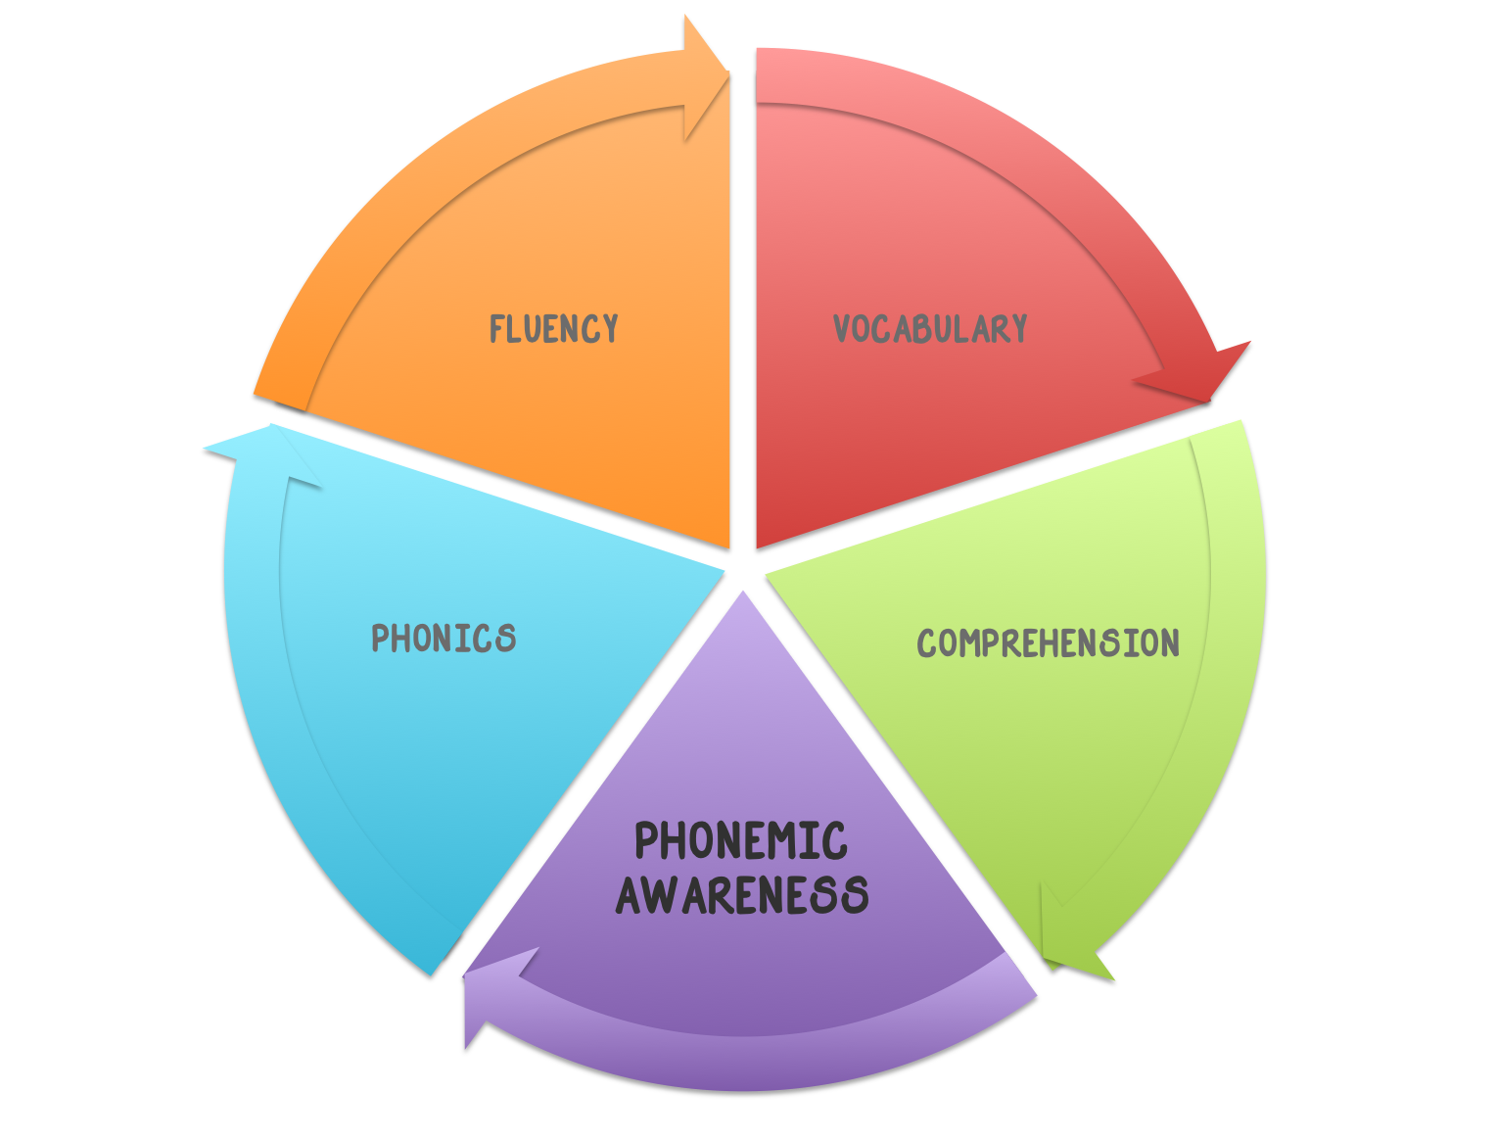
Phonemic Awareness
Phonemic Awareness is the ability to hear, identify, and manipulate individual sounds-phonemes - in spoken words
Phonemic Awareness can be measured in 3 ways:
sound comparison, segmentation and blending
Notes:
Directly related to reading ability
Reliable predictor of later reading ability
Deficits in PA are usually associated with deficits in reading

Slide 14

Assessment / Progress Monitor
Phonemic Awareness
PALS Quick Checks

Slide 15
Phonemic Awareness Strategies
Phoneme Isolation - What is the first sound in van?
Phoneme Identify - What sound is the same as in fix, fall and fun?
Phoneme Categorization - What word doesn’t belong bus, bun, rug?
Phoneme Blending - What word is /b/ /u/ /g/? Then write & read the word.
Phoneme Segmentation - How many sounds are in grab? Then write & read.it.
Phoneme deletion - What is smile without the /s/?
Phoneme addition - What word do you have if you add /s/ to the beginning of park?
Phoneme substitution - The word is bug, change /g/ to /n/. What’s the new word?

Slide 16
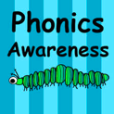
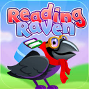
Phonemic Awareness Technology
Free
Phonics Awareness Reading Raven
Free $3.99

Slide 17
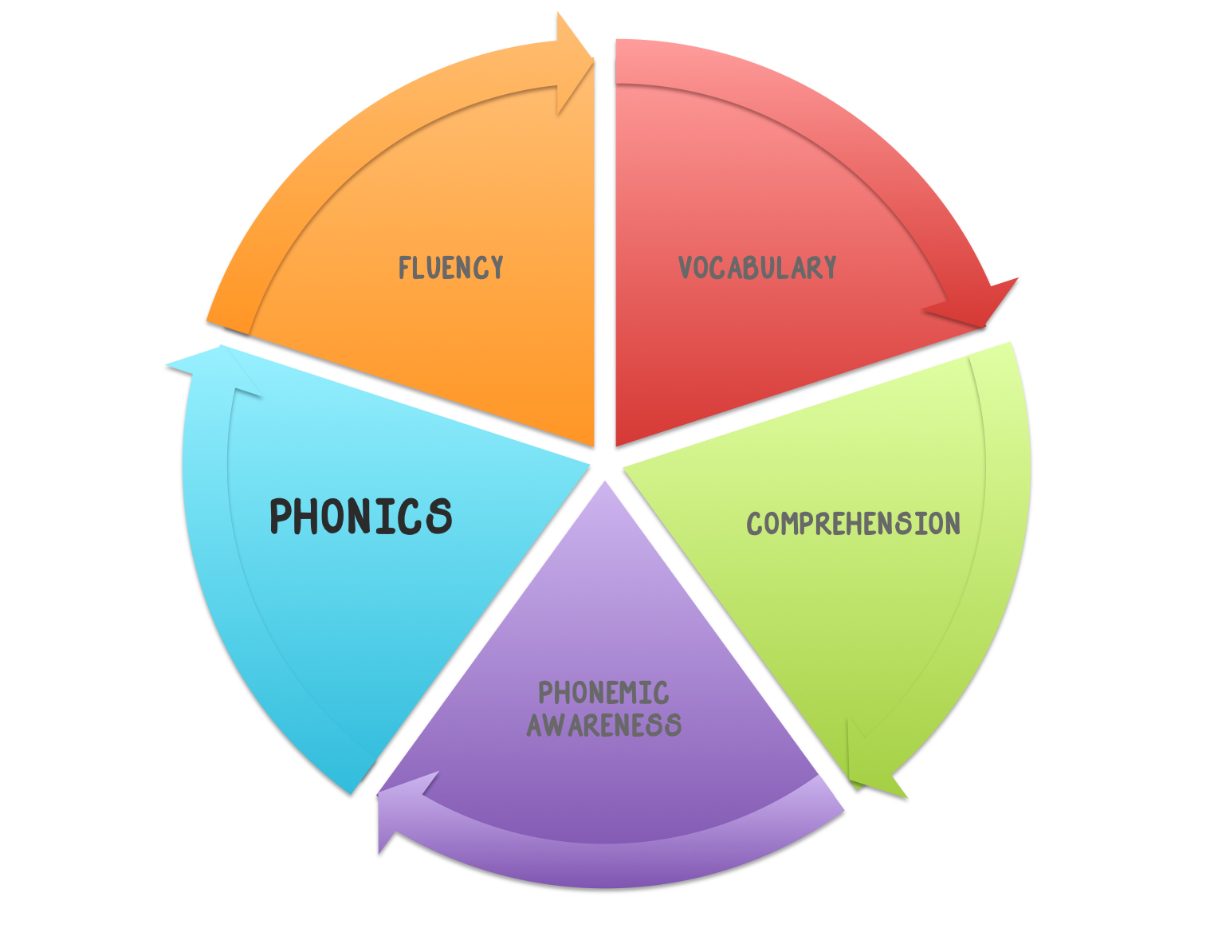
Phonics
Phonics is the knowledge that letters of the alphabet represents phonemes, and that these sounds are blended together to form written words.
Rapid and accurate decoding is the foundation of proficient reading (Rathvon, 2008)

Slide 18
Assessment / Progress Monitor
Phonics Instruction
PALS Quick Checks

Slide 19
Phonics Strategies
Systematic (carefully selected set of letter-sound relationships)
Explicit - direct explanation, modeling, practice, application.
On a continuum of instruction - letter sounds, blending, onset-rime
Multi-sensory Approach
Phonetic Concepts & Rules
PALS activities
Controlled Text (Phonics Readers) Reading A-Z
Notes:
Multisensory learning involves the use of visual, auditory, and kinesthetic-tactile pathways simultaneously to enhance memory and learning of written language.

Slide 20
Technology to Support Phonics
Multisensory Literacy Apps
Notes:
In worskstation section of notebook

Slide 21
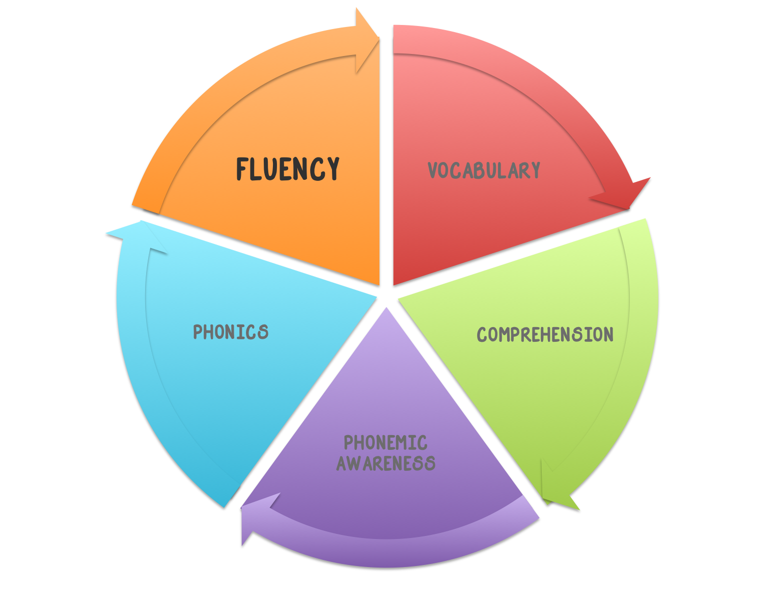
Fluency
The ability to read text accurately and quickly. It frees students up cognitively so they can understand what they read.
Comprehension is significantly impaired for students who misread more than 5% of the text or read less than 100 words per minute in second grade & above. (Grossen & Carnine, 1991)
Notes:
Fluency is an essential feature of proficient reading. Dysfluent readers are exposed to less text and avoid reading due to frustration leading to less vocabulary and content (Stanovich, 1986)en Dc

Slide 22
Assessment / Progress Monitor
Fluency Growth
Timed Repeated Readings - student reads the same passage for 1 minute multiple times (3-5). the teacher/ partner counts how many words the student reads correctly in 1 minute. The number of words is then graphed using a bar graph. *Passages should be at students independent reading level
PALS
Running Records - Words Per Minute Calculator

Slide 23
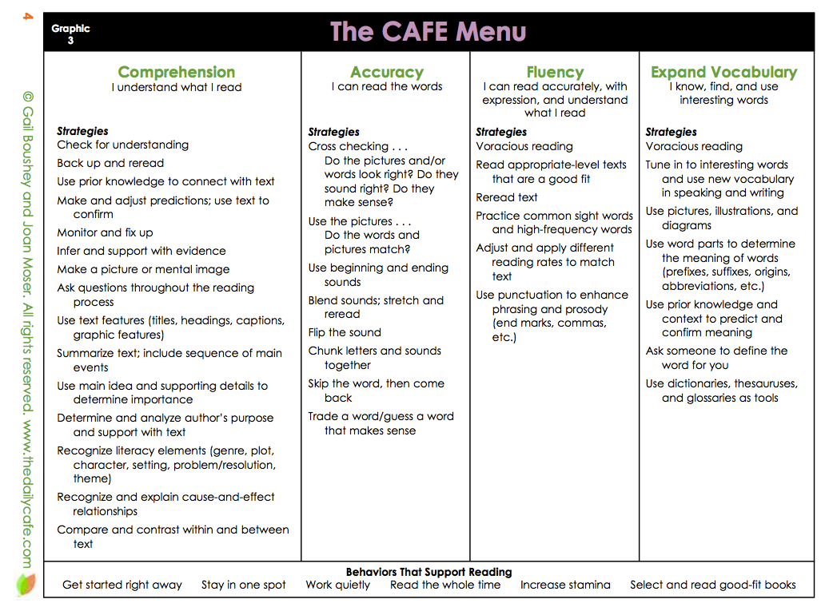
Fluency Strategies
Repeated Readings - like athletes practice
Echo Reading
Partner Reading
Tape-Assisted Reading
Reader’s Theater
Poetry
Songs
CAFE
Tim Rasinski Materials
Research supports the need for daily instruction in fluency which includes oral reading and corrective feedback (Chard et al, 1998)
Notes:
Repeated oral reading practice has been shown to improve reading rate, accuracy & comprehension
the optimal number or repeated readings appears to be 4.

Slide 24

Technology to Support Fluency
Audio Memos
Record student reading using high quality audio and email results for data collection
Notes:
Use to progress monitor
Let student listen to himself
Show student their growth
Email files to classroom teacher for conferences

Slide 25
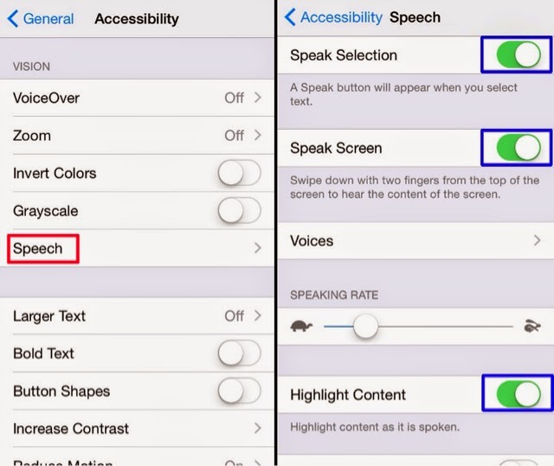
Speak Screen and Speak Selection
Accessibility Features
Apple iOS
Assists with reading emails, web pages, and books to you
Two finger swipe from top down or just tell Siri to Speak Screen
Adjust the voice’s dialect and speaking rate, and have words highlighted
Turn on Speak Selection and hold your finger down over a word to highlight
Drag the bottom right dot over your text, select speak from popup to hear the highlighted text

Slide 26
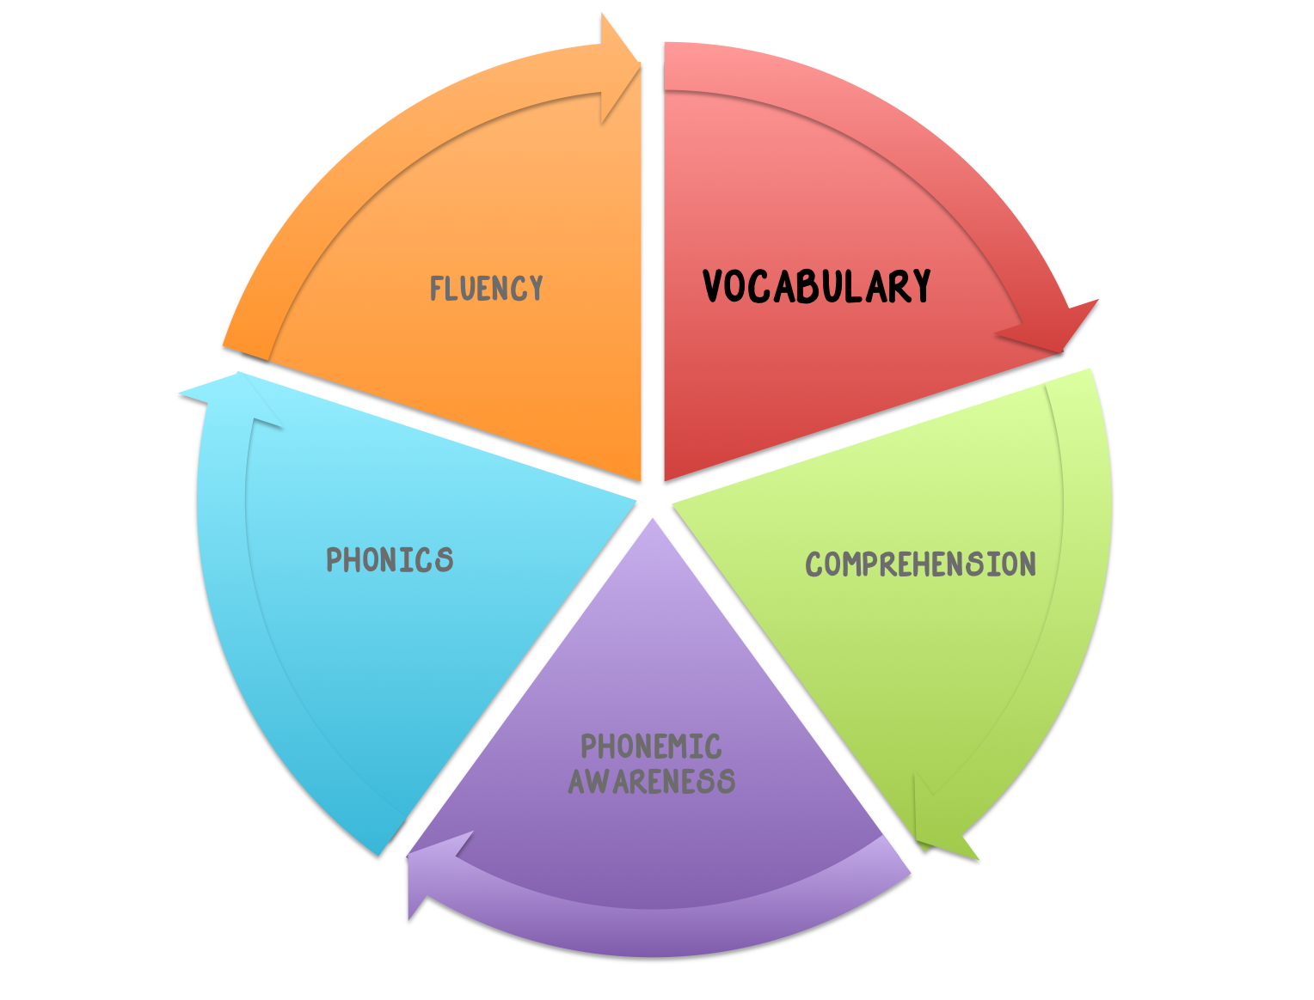
Vocabulary
Vocabulary is defined by the National Institute for Literacy as the words we must know to communicate effectively. These words can be described as oral vocabulary or reading vocabulary (NIFL, 2001).
Knowing some common prefixes and suffixes (affixes), base words, and root words can help students learn the meaning of many new words. For example, if students learn just the four most common prefixes in English (un-,re-,in-,dis-), they will have important clues about the meaning of about two thirds of all English words that have prefixes (NIFL, 2001).

Slide 27
Assessment / Progress Monitor Vocabulary Growth
Student created vocabulary dictionary/Word Bank
Quizlet
Informal Reading Inventory (IRI)
Flocabulary
EdHelper

Slide 28
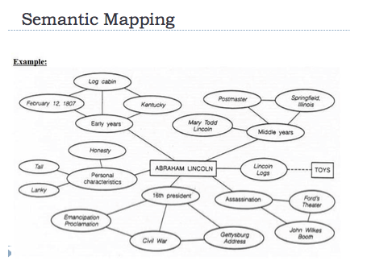
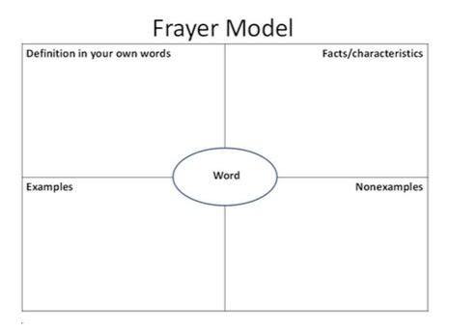
Vocabulary Strategies
Semantic Mapping Frayer Model
Research shows that knowledge is stored in categories and that words are linked in our memory to other words based on their relationship to each other (Rumelheart, 1980) Vocabulary Strategies

Slide 29

Technology to Support Vocabulary
Read & Write for Google
Free with Google Apps for Education account
This extension allows for read aloud of websites and Google Docs and also includes word prediction, image dictionary, highlighter, and much more for.
Link to extension

Slide 30
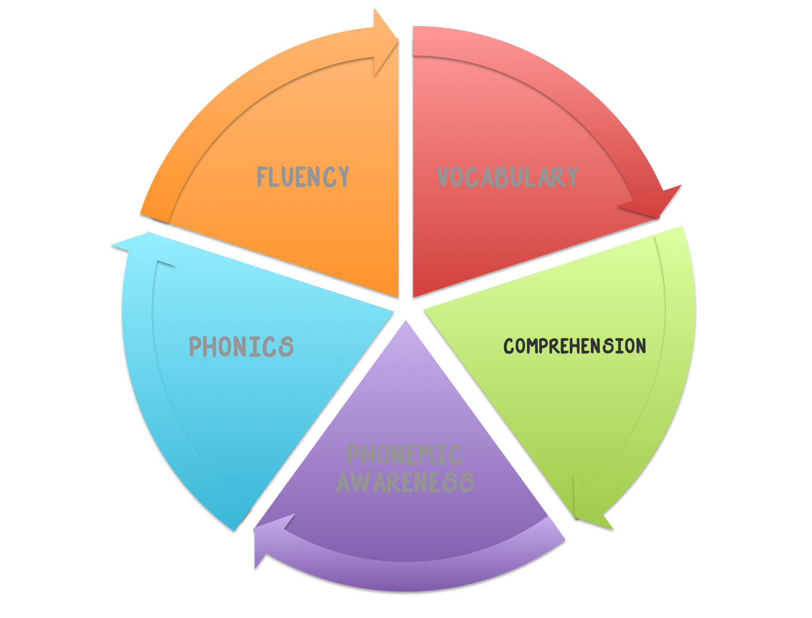
Comprehension
Comprehension is the reason for reading!
Before: Clarify purpose and do a story walk to activate prior knowledge
During Reading: Monitor understanding, adjust reading speed and use strategies
After Reading: Retelling & Summarizing
Comprehension is impaired when too much energy is allocated to the decoding process (Share 1995; National Reading Panel 2000; Rathvon 2008)

Slide 31
Assessment / Progress Monitor Comprehension
Retell
Sequence
Predict
Make Inferences
Draw Conclusions
Summarize

Slide 32
Comprehension Strategies
Anticipation guide - Activate Prior Knowledge
KWL Strategy - Non-Fiction
Story mapping (storyboarding) - Fiction
Graphic Organizers - various genres
CAFE - Comprehension, Accuracy, Fluency, Expand Vocab.
53 Ways to Check for Understanding

Slide 33
Technology to Support Comprehension
ReadWorks
TweenTribune
Newsela
Free
Real World Articles
Leveled Text
Research-based Units
Lessons
Assessments
Authentic Nonfiction Passages
Paired Passages
Question Sets

Slide 34
Specially-Designed Instruction
Students with disabilities should have a research based intervention that is explicit and systematic in a small group

Slide 35


Phonics
(available for checkout through the T/TAC @ VT lending library)
Wilson Reading System
Grades 2nd and above
Orton Gillingham Approach
Grades K and above
VIDEO
Notes:
5-day training this summer in Salem most likely be in August. The cost is $1095 per an individual. Contact Randy Jennings

Slide 36

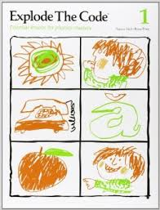
Phonemic Awareness Programs
(available for checkout through the T/TAC @ VT lending library)
FUNdations®
www.fundations.com
Grades K-3
Explode the Code
Pre-K-1
www.explodethecode.com

Slide 37
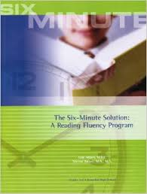
Fluency Program
(available for checkout through the T/TAC @ VT lending library)
Six Minute Solution
Kindergarten through 9th grade

Slide 38
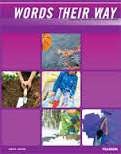

Vocabulary Programs
(available for checkout through the T/TAC @ VT lending library)
Words Their Way:
Word Study in Action Developmental Model
http://www.pearsonschool.com/
Research
Grades K-5
Just Words®
www.justwords.com
Grades 4-12

Slide 39
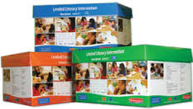

Comprehension Programs
(available for checkout through the T/TAC @ VT lending library)
Leveled Literacy Intervention System (LLI)
http://www.heinemann.com/product s/E01198.aspx
Grades K-5
READ 180 ®
Grades 4th-12th

Slide 40
Showcase of Literacy Materials available in the lending library at T/TAC @ VT

Slide 41

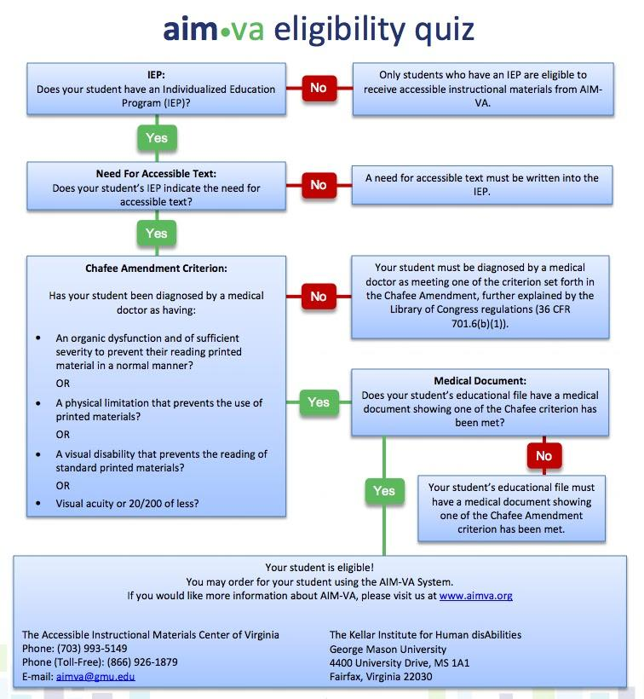
Accessible Instructional Materials
Free accessible textbooks & other reading materials to eligible K-12 students with IEP’s in VA (not through third party like Amazon though)
AIM-VA
Notes:
A student with a print disability due to one of the following
blindness,
visual disability,
physical limitation,
reading disability resulting from organic dysfunction.

Slide 42

Turn & Talk
How does your school/district assess the five components of reading?
How do those assessments drive your differentiated instruction?
Notes:
Think about your guiding questions and make notes in your participant journal

Slide 43
Breakout Sessions
Assessment (room 226)
Guided Reading (room 240)
Literacy Stations (room 231)

Slide 44
Guiding Questions
How long is the daily literacy block?
How much reading instruction is done in small group?
What assessments are currently used to guide reading instruction?
What materials are used during reading instruction?
Are students provided opportunities for purposeful independent reading?

Slide 45
Action Plan
What steps will ensure differentiation during your literacy block?

Slide 46
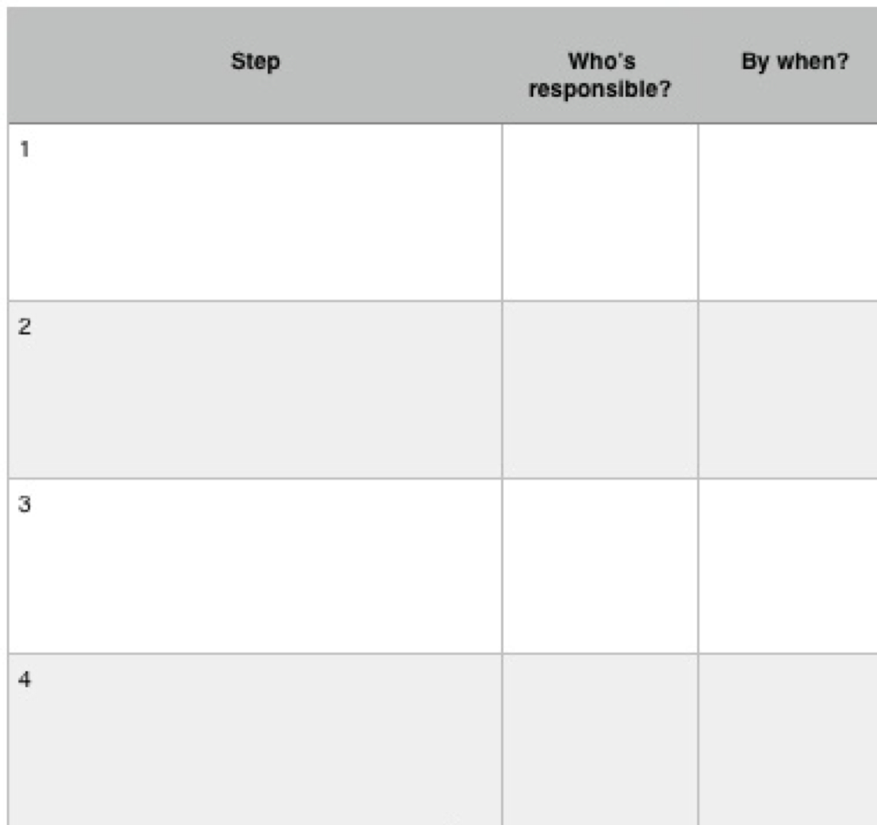
Action Plan

Slide 47
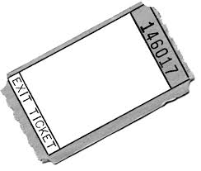
EXIT Ticket: http://tinyurl.com/gl8lobz
Evaluations: Please fill out the evaluation form

Slide 48
Resources:
http://www.janrichardsonguidedreading.com/video-clips
http://www.lesley.edu/guided-reading/#components
http://www.readwritethink.org/professional-development/strategy-guides/using-guided-reading-develop-30816.html#research-basis
http://education.ucf.edu/mirc/Research/Balanced%20Reading.pdf
http://mnps2010.wikispaces.com/file/view/Balanced+Literacy+Reference+Guide+2012.pdf

