Slide 1
Differentiation Through
Wendy Phillips , M.S., Literacy Specialist
Coordinator of Reading
Virginia Department of Education’s
Training & Technical Assistance Center (T/TAC)
@ Virginia Tech

Slide 2
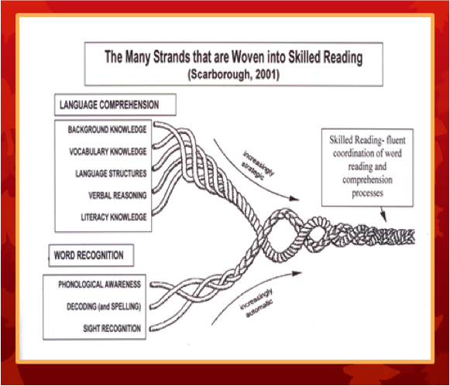
The ultimate goal of reading is to make meaning of what we have read. Comprehending text involves a complex process of intertwining skills as visually demonstrated through Scarborough’s “Reading Rope” (2001).
Notes:
When one strand is compromised, the strength of the rope is compromised thus hindering the comprehension of the text being read.

Slide 3
What is Guided Reading?

Slide 4
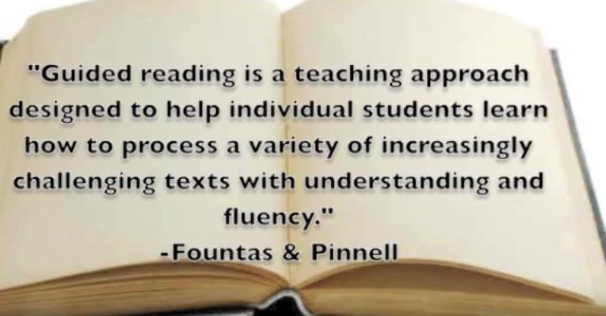

Slide 5
As outlined in the work of Fountas and Pinnell,
“Guided Reading is a context in which a teacher supports each reader’s development of effective strategies for processing novel texts at increasingly challenging levels of difficulty”
(Fountas & Pinnell, 1996, p. 3)

Slide 6
Guided Reading Is…...
Teacher works with 2-6 students in a small group.
Children are grouped according to similarities in reading development and or instructional reading levels
Teacher introduces stories, strategies, and concepts within the group to increase independent application in appropriate leveled text.
Every child reads and is supported by the teacher. (NOT ROUND ROBIN)
Emphasis is on strategic problem solving
It can be adapted for any grade.

Slide 7
Teacher selects books
Groups are dynamic; they change in response to assessment; they are flexible and fluid
Teachers teach word solving, searching for & adjusting information, self-monitoring and correcting, summarizing, maintaining fluency, adjusting for purpose & genre, predicting, making connections, synthesizing, inferring, analyzing and critiquing Pinnell & Fountas, 2008)
Teacher uses explicit instruction of reading strategies
Teacher incorporates explicit vocabulary instruction, phonics & word work

Slide 8
Guiding Reading is NOT
A complete reading program
Consistent use of basal text
Whole group instruction
Writing vocabulary definitions
Writing without purpose
Round robin reading/Popcorn reading
Sustained silent reading
Just for young children

Slide 9
https://www.teachingchannel.org/videos/guided-reading-introduction#

Slide 10
Turn & Talk
How does Jenna model expectations for workstations?
How do students transition among tasks?

Slide 11
Elements of Guided Reading
Form small group
Identify emphases
Select a Text
Analyze the text
Introduce the text
Support student’s reading of text
Guide discussion
Engage in specific teaching for processing strategies
Support student’s work with letters & words
Extend understanding through writing about reading

Slide 12
Essentials of Guided Reading:
Small dynamic groups (using systematic assessment)
Instructional leveled texts & targeted teaching
Literacy Stations (small group management)

Slide 13
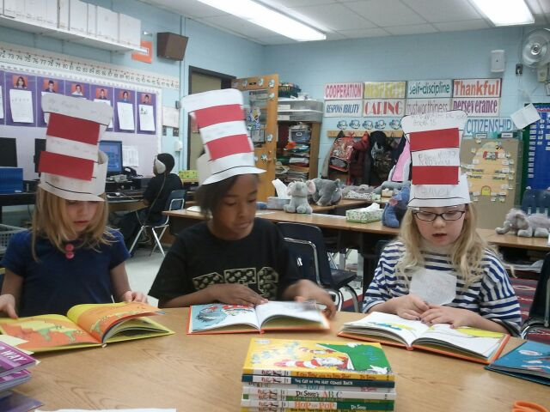
Small Dynamic Groups
Size of each group: 1-3 lowest readers, 3-5 for struggling readers and 5-7 for highest readers

Slide 14
Grouping
Placement is flexible and fluid, adapting to student’s needs; teachers must continuously diagnose needs through observations
Groups can be formed by strategy need or reading level (using STAR, PALS, running records,etc.)

Slide 15
Running records will inform not only the selection of an appropriate text but the specific emphases to prioritize for your students. #FPLiteracy

Slide 16
Levels
Independent: 95-100%
Instructional: 90-94%
Frustration: Below 90%
Self correction goal 1:1- 1:3

Slide 17
Level L-M L- Lexis L- Casey M- Kameron S. M- Tyler M- Kiara | Level I, J, K J- Julietta J- Aklexia K- Adam K- Cameron
Level N (M) Cheyanne Zach Jacob B. Logan Jacob L. Brittany | Level N-O Adrianna Lilly Linda William Brady Zach L.
Level Q Ben W. Christina Joey Adam W. Harbal Jenna | Level O-P Courtney Darius Carli Sully Isaiah T.J.
Level S S- Joe D. S- DJ S- Riley S- Haley S- Eva S- Rigil | Level T-X T- Beau U- Megan V- Rishi W- Abby X- Tim

Slide 18
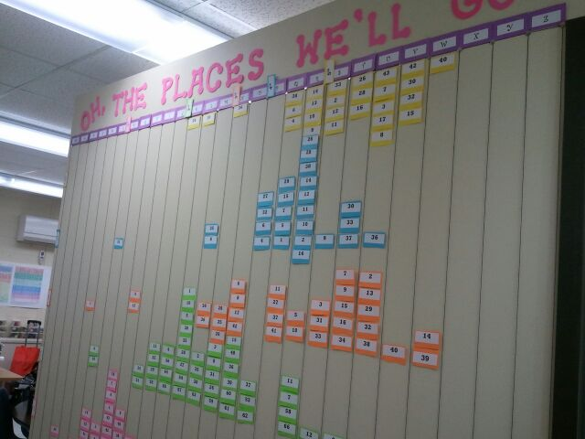
Data Wall & Spreadsheets
Notes:
Show F&P growth chart

Slide 19
Reading Tracker Sheets

Slide 20
2. Instructional Leveled Text
Basal Readers (high, medium, low)
A-Z Readers
Scholastic Readers
F&P Readers
Etc.
Notes:
Choose text based on skill or strategy
I.e. if working on fluency, then choose a reread or lower level book

Slide 21
Targeted Teaching
Prompting Guide
Jan Richardson
Book Prompting Guide
Literacy Continuum
Reading Strategies

Slide 22
A typical structure of a Guided Reading lesson
Selecting the text
Introducing the text
Reading the text
Discussing the text
Teaching for strategic activities
Extending meaning (optional)
Word Work (optional)
A typical Guided Reading lesson occurs as students read text that has been selected to be at an appropriate level of difficulty

Slide 23
Before
Picture walk
Conversation
Genre
Set purpose
Preview vocabulary
Build prior knowledge
Connect to text with reread
Make predictions
Anticipation guide, KWL, thinking map

Slide 24
During
Focus on Comprehension strategy while students read/reread text
Choral
Echo
Partner
Independent
(NOT ROUND ROBIN)
CAFE (Comprehension, Accuracy, Fluency & Expanding Vocabulary)
Notes:
Students whisper read while teachers confers one on one and encourages problem-solving strategies

Slide 25
After
Graphic Organizers
Storyboarding
Summarize
Questioning
Discussion
Independent reading
Extend learning
Act our story
Draw or write a response

Slide 26
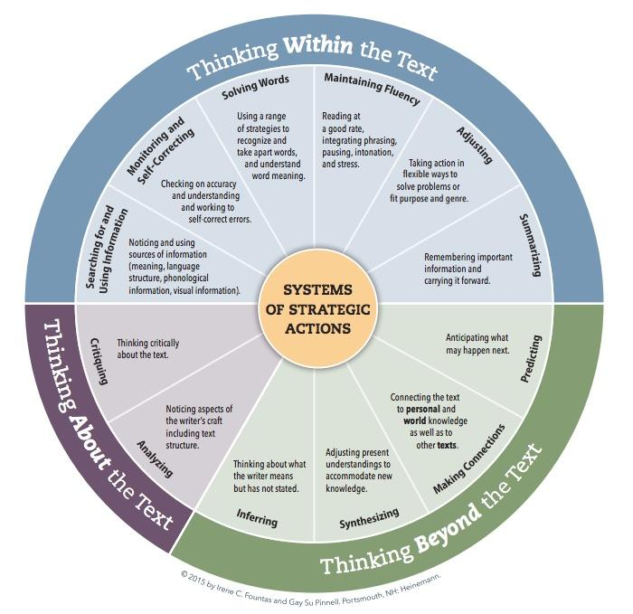
Notes:
Refer to comprehension section of packet

Slide 27
3. Literacy Stations
Listening Station
Writing Station
Word Study Station
Classroom Library Station
Technology Station
Guided Reading
Notes:
Ar books can be used as an independent station

Slide 28
Answer these questions in your booklet
What resources are currently available?
2. What resources do you need?

Slide 29
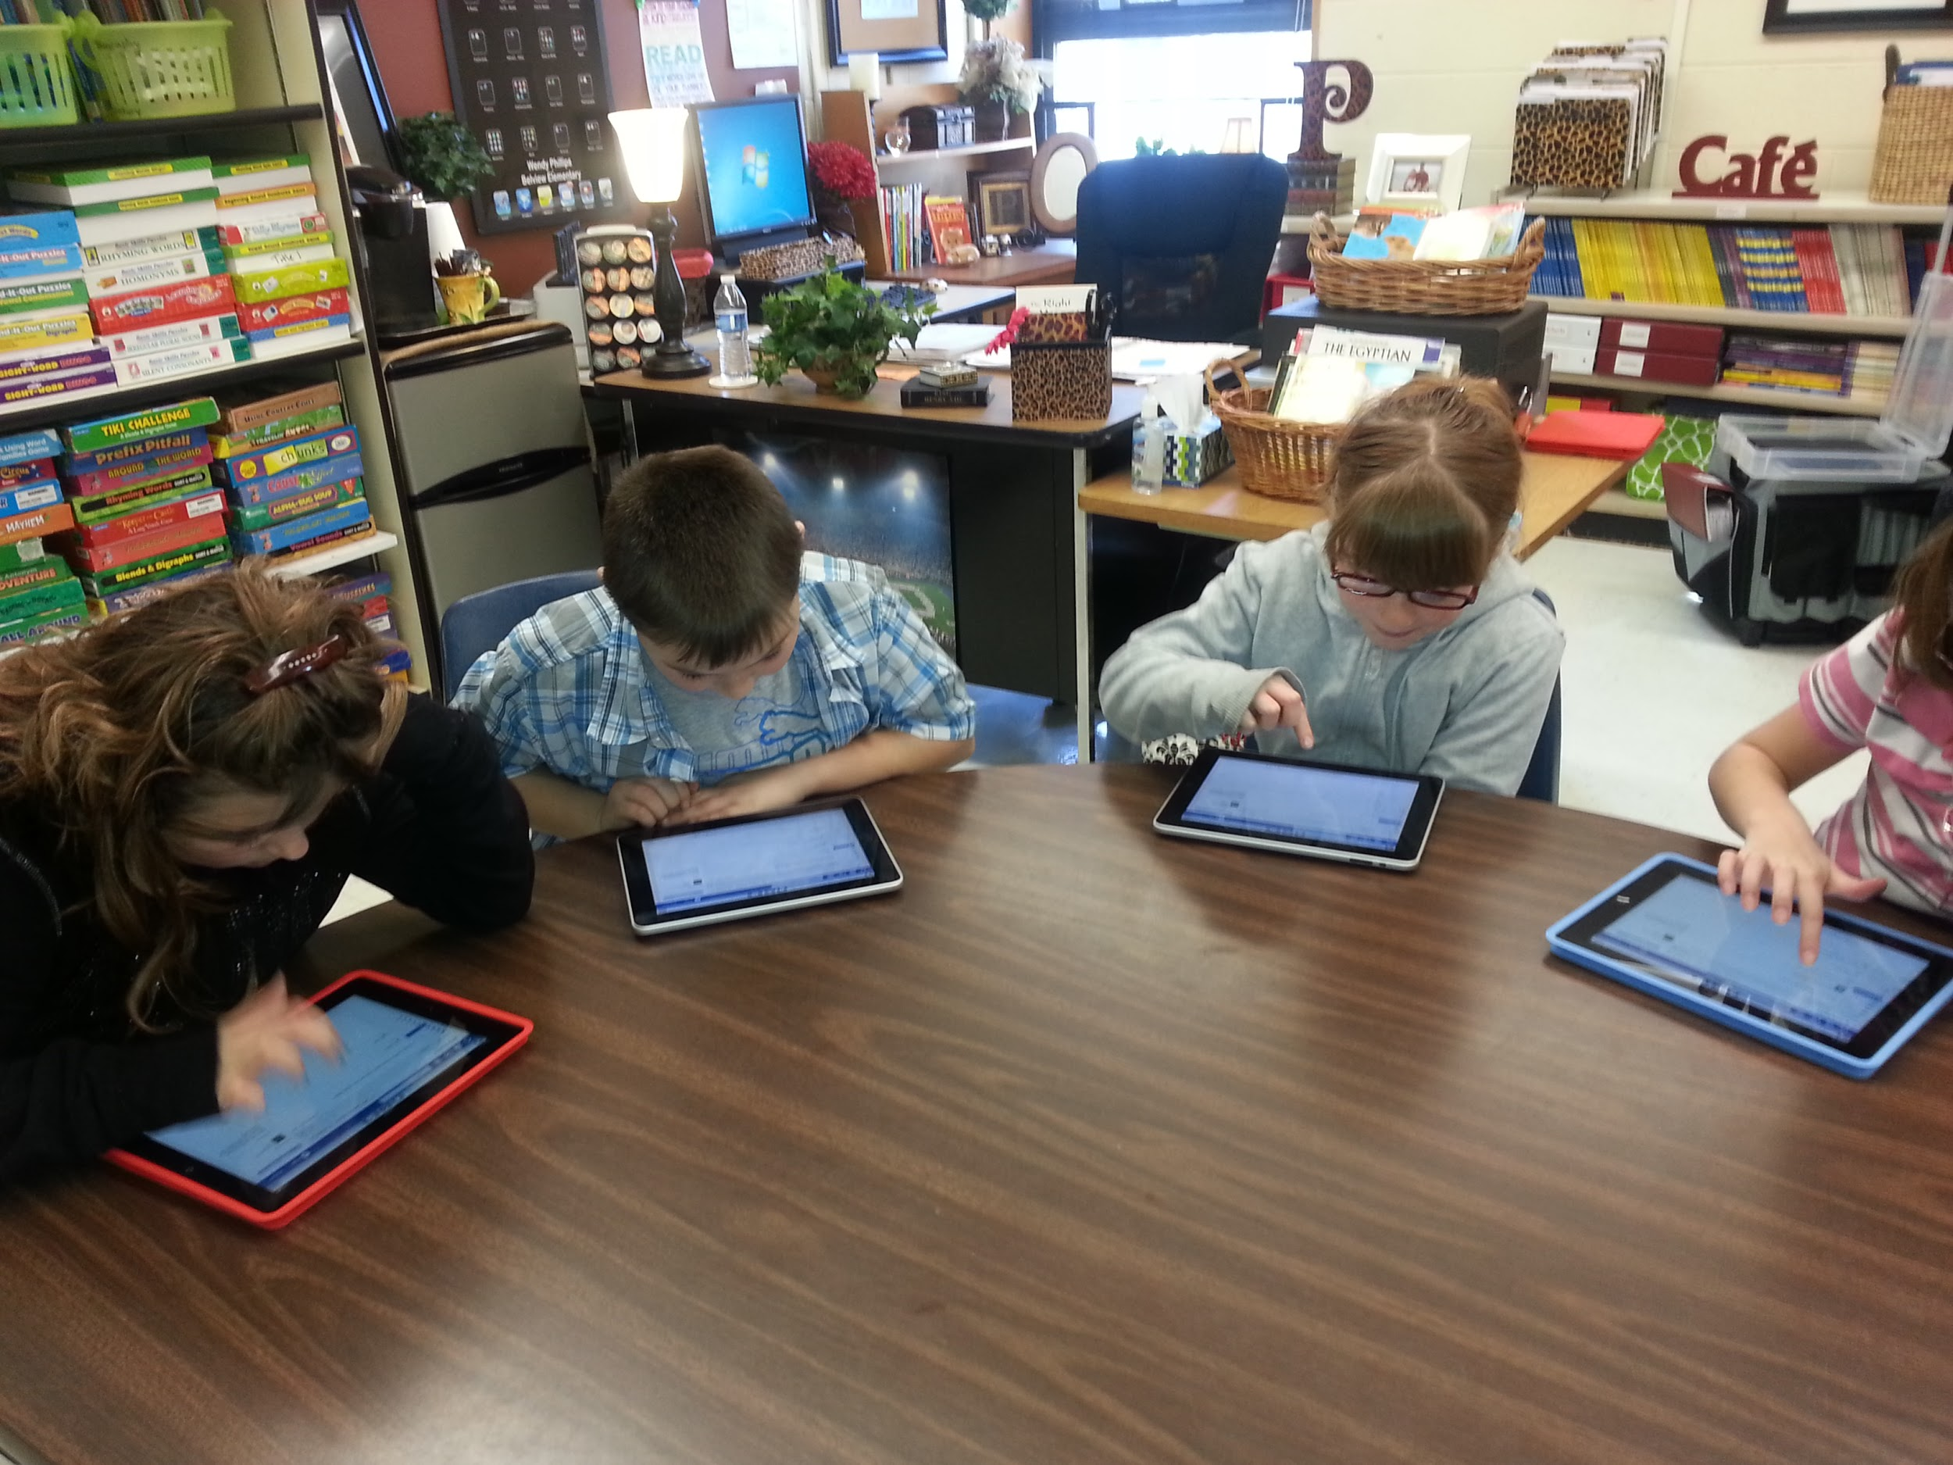
Digital Access to Text
ReadWorks, Newslea, TweenTribune

Slide 30
Intermediate/Middle Grades
Many activities can be adapted for intermediate scholars!
Students should be reading self-selected books and writing about them while the teacher does guided reading

Slide 31
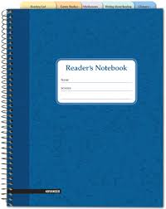
A reading notebook is a tool for monitoring and assessing independent reading and guided reading
Independent Reading Record
Independent Reading Response (one page response)
Guided Reading Notes (summaries, graphic organizers, strategy focus)
New Word List (2 columns with new vocabulary word and synonym)

Slide 32
Reader’s Notebook
Engaging in critical thinking
Learning how to interpret a text
Making connections between texts/genres
Connecting reading and writing
Promoting active discussion
Continually responding and reflecting on a text
Examining the writer’s craft
Not for “red ink” corrections

Slide 33
Reader’s Workshop Structure
Book Talks & Minilessons | 5-10 minutes
Students: Teacher: Independent Reading Guided Reading Groups (20-25 minutes each) Writing in Reader’s Notebooks Book Clubs (20 minutes each) Individual Conferences (3-5 minutes each) | 50-60 minutes
Group Share | 5 minutes
Students must have choice during independent reading

Slide 34
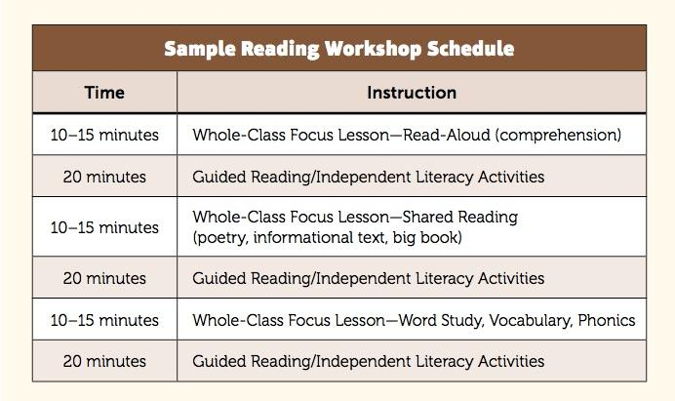
Richardson, J. (2016). The next step forward in guided reading: an assess-decide-guide
framework for supporting every reader. New York, NY: Scholastic

Slide 35
According to the
National Institute of Literacy
For middle and high school teachers, the use of guided oral reading in classes limited to an hour or less of instructional time requires that teachers target a small group of their most struggling readers and alternate working with one or two of them daily during those times when other students are engaged in group or individual work. Guided oral reading involves:
1. Asking individual students to read aloud,
2. Guiding them to self-correct when they mispronounce words, and
3. Asking questions about content to ensure comprehension.
https://lincs.ed.gov/publications/pdf/adolescent_literacy07.pdf

Slide 36
Obvious truth about reading instruction is that students learn to read by reading—they learn to read well by reading w/proficiency every day #FPLiteracy

Slide 37
Resources:
http://www.janrichardsonguidedreading.com/video-clips
http://www.lesley.edu/guided-reading/#components
http://www.readwritethink.org/professional-development/strategy-guides/using-guided-reading-develop-30816.html#research-basis
http://education.ucf.edu/mirc/Research/Balanced%20Reading.pdf
http://mnps2010.wikispaces.com/file/view/Balanced+Literacy+Reference+Guide+2012.pdf
Pinnell, G.S., & Fountas, I.C. (2010). Research base for guided reading as an instructional approach (White paper). Scholastic.

